Slide 1
Analyzing Aftershock Sequences in Bogo City, Cebu using Unsupervised and Supervised Learning
Charrie Anne S. Nacor
Joanna Marie M. Pagtalunan

Slide 2
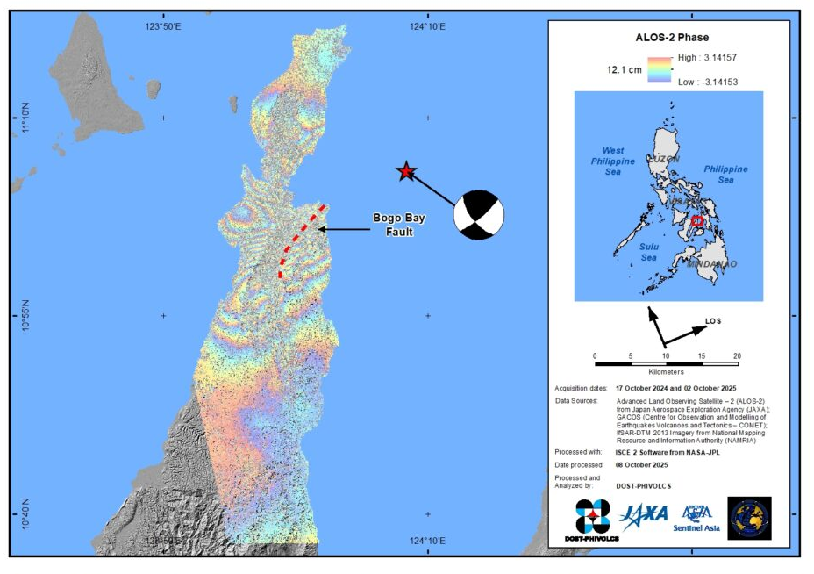
Introduction & Problem Statement
On September 30, 2025, a deathly magnitude 6.9 earthquake struck offshore near Bogo City, Cebu, in an area previously considered a low-risk due to low seismic activity over the past 400 years.
Problem Statement: The rupture revealed a previously unidentified fault system –Bogo Bay Fault-- highlighting the need for detailed post-event analysis to better understand its geometry and seismic activity.
Research Hypothesis: The aftershock sequence of the 2025 Bogo City earthquake contains distinct, separable clusters driven by differences in location, depth, magnitude, and timing. These clusters will exhibit high separability under supervised models (SVC and XGBoost), thereby validating the feature-importance patterns observed in the unsupervised analysis.
The 6.9 magnitude earthquake exposed a previously unknown fault, the Bogo Bay Fault.
Satellite Image of the Surface rupture of the Bogo Bay Fault during the 2025 Magnitude 6.9 Northern Cebu
Retrieved from: https://www.phivolcs.dost.gov.ph/satellite-image-of-the-surface-rupture-of-the-bogo-bay-fault-during-the-2025-magnitude-6-9-northern-cebu/
Notes:
PHIVOLCS field teams found about 200 meters of visible ground rupture in Sitio Looc, Barangay Nailon, Bogo City.

Slide 3
3,050 aftershocks were recorded within a month.
Notes:
“Every aftershock maps the rupture zone," Bacolcol said. "The pattern shows us the fault's extent, where stress has been released, and potentially where it remains."

Slide 4
Can we identify distinct, meaningful clusters within this aftershock sequence to better understand the seismic activity?

Slide 5
Our Approach: A two-step methodology
Unsupervised Learning
Supervised Learning
Identify natural groupings in the data
Validate if these groupings are meaningful and well-separated

Slide 6
Our Approach: A two-step methodology
Unsupervised Learning
Supervised Learning
K-Means
K-Medoids
SVM
XGBoost
Clustering Algorithms
Classification Algorithms

Slide 7
Experimental Workflow
Dataset
Unsupervised Learning
Supervised Learning
K-means
Cluster Characteristics
SVM
Pre-processing
K-medoids
Train/Test
70-30
XGBoost
EDA

Slide 8
Step 1: Unsupervised Learning

Slide 9
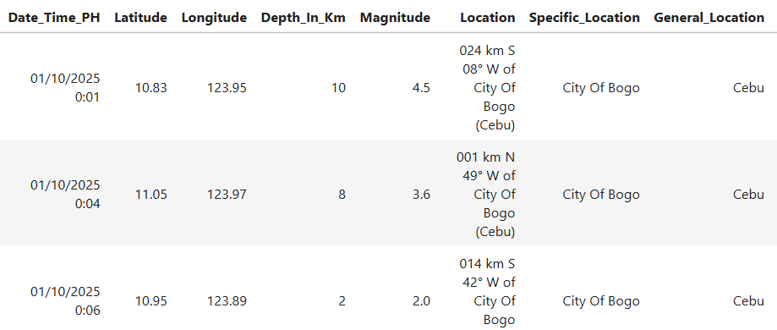
PHIVOLCS recorded 3,050 earthquakes in Bogo City, Cebu, from October 1-30, 2025, with magnitudes ranging from 1.0 to 5.8 and depths from 1 to 60 km.

Slide 10
Is our data even clusterable?

Slide 11
Is our data even clusterable?
We used the Hopkins Statistic to assess clustering tendency.

Slide 12
Is our data even clusterable?
We used the Hopkins Statistic to assess clustering tendency.
Result
0.9994
H > 0.5, which means the data has a significant tendency to cluster.

Slide 13
Experimental Workflow
Dataset
Unsupervised Learning
Supervised Learning
K-means
Cluster Characteristics
SVM
Pre-processing
K-medoids
Train/Test
70-30
XGBoost
EDA
Diagnostic Metrics
Hopkins Statistic
Elbow Method
Silhouette Score

Slide 14
We need to find the best ‘k’ for our clustering algorithms.
We used the Elbow Method, which plots the within-cluster variance against the number of clusters.

Slide 15
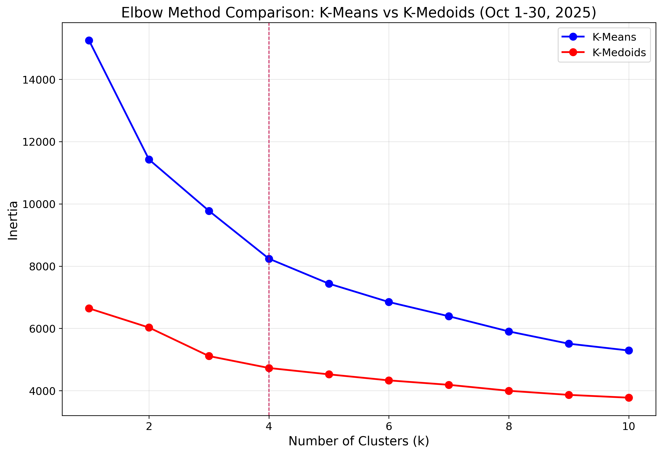
This suggests that four is the most natural number of clusters in the data.

Slide 16
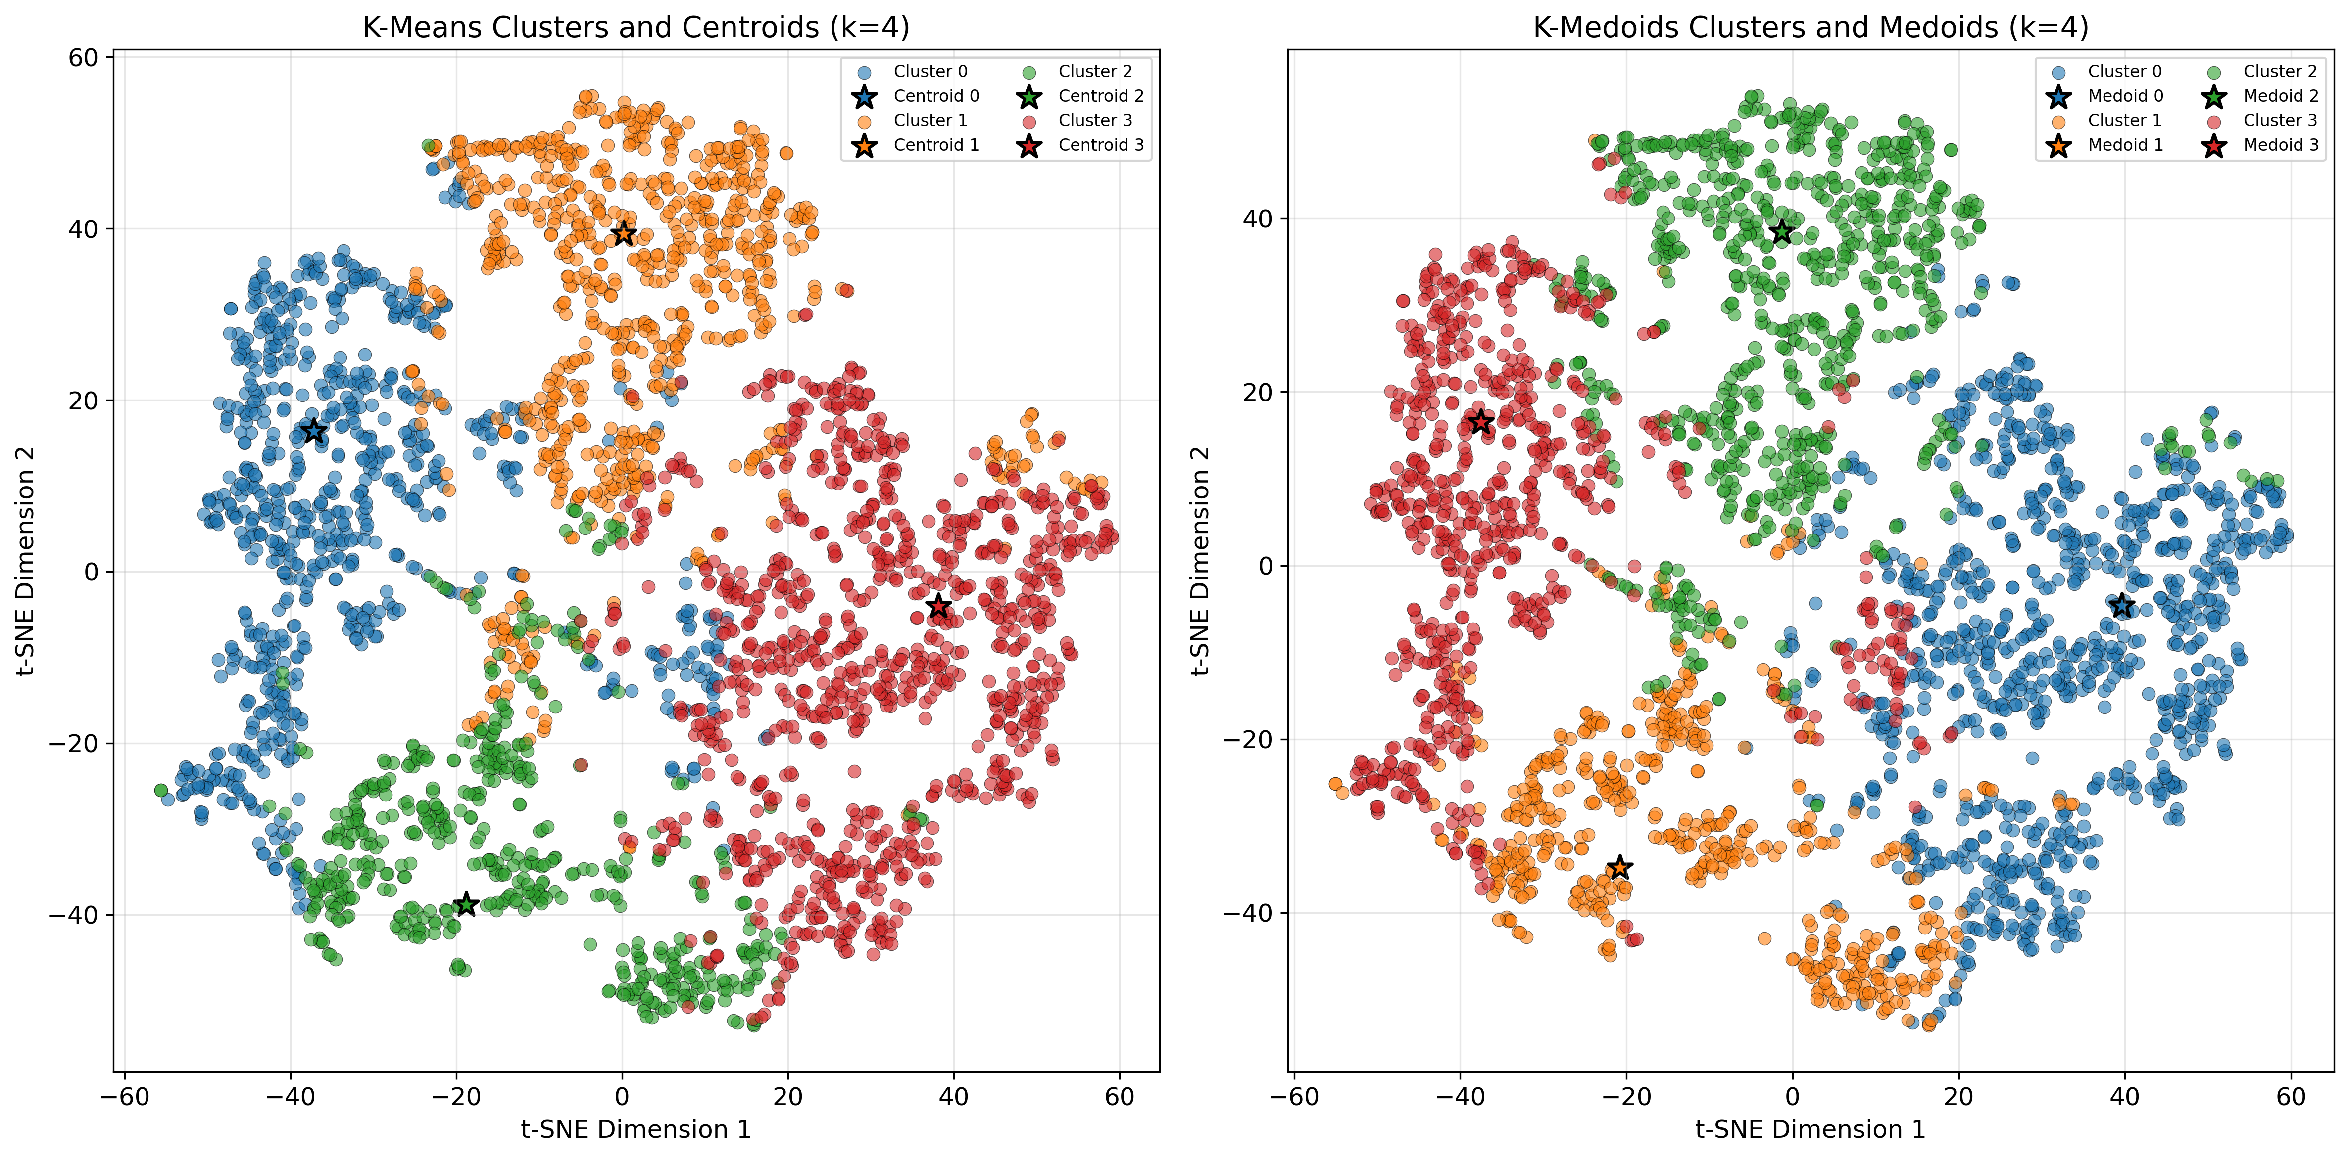
Silhouette Score = 0.2373, Time = 0.0057s
Silhouette Score = 0.2353, Time = 3.4539s

Slide 17
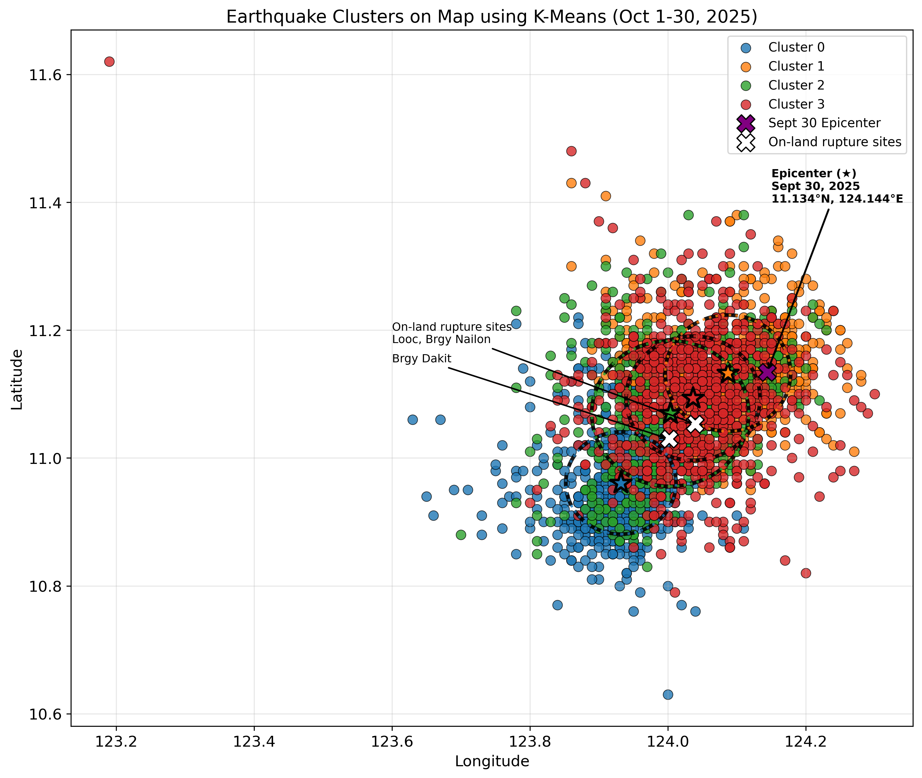
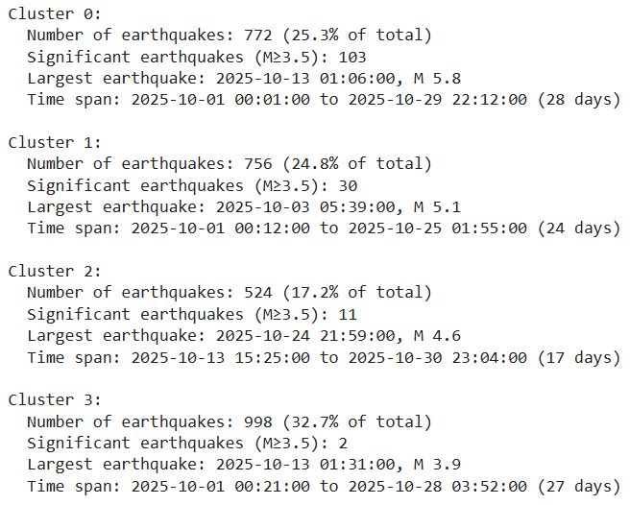
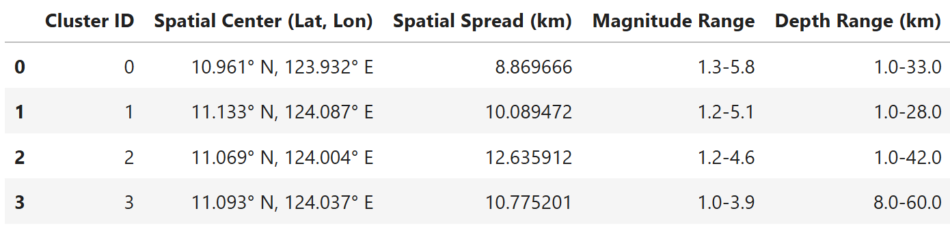

Slide 18
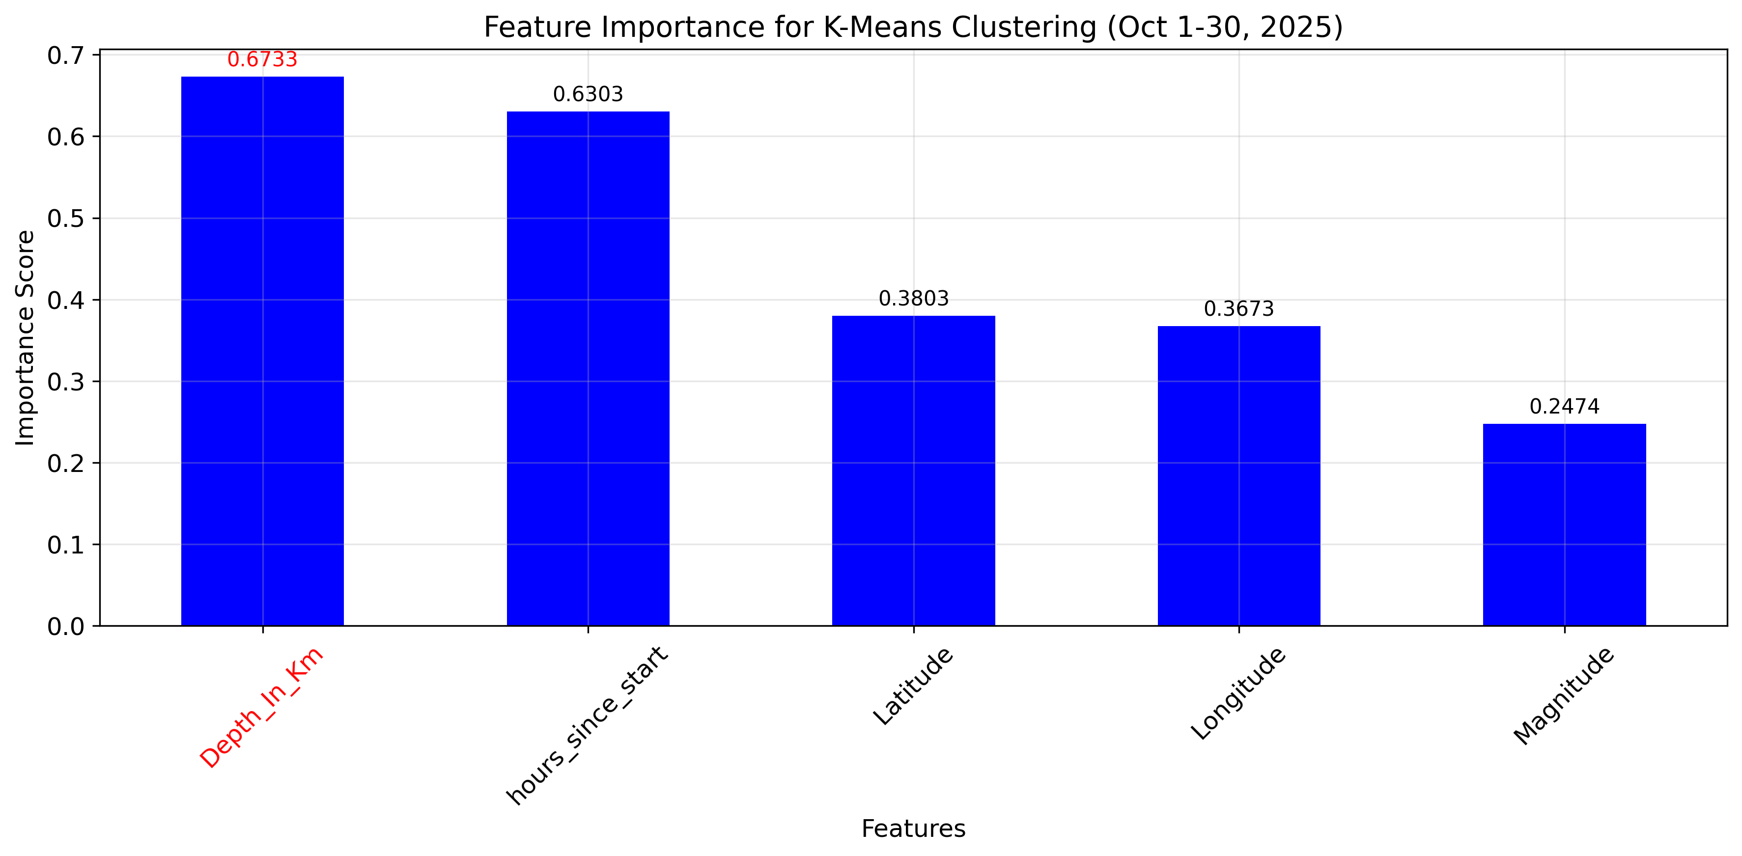

Slide 19
Step 2: Supervised Learning

Slide 20
Test if the clusters identified by K-Means are truly meaningful and well-separated.
Train classifiers to predict the cluster label of an earthquake based on its features.

Slide 21
Experimental Workflow
Dataset
Unsupervised Learning
Supervised Learning
K-means
Cluster Characteristics
SVM
Performance Metrics
Pre-processing
K-medoids
XGBoost
Classification Report
Train/Test
70-30
EDA
Diagnostic Metrics
Hyperparameter Tuning
Hopkins Statistic
Elbow Method
Silhouette Score
GridSearchCV

Slide 22
70%
training set
30%
test set

Slide 23
Hyperparameter Tuning using GridSearchCV
SVC
XGBoost
C: 0.1, 1, 10, 100
gamma: 1, 0.1, 0.01, 0.001
kernel: rbf, poly, linear
3-fold cross validation
max_depth: 3, 5, 7
min_child_weight: 1, 3, 5
learning_rate: 0.01, 0.1, 0.2
subsample: 0.8, 0.9, 1.0
colsample_bytree: 0.8, 0.9, 1.0
3-fold cross validation

Slide 24
Best Hyperparameters
SVC
C: 100
gamma: 1
kernel: linear
Notes:
Strict hyperparameters and the best kernel is linear even this is a 5D feature space
This suggest that the earthquake clusters identified occupies a distint region that can be separated by flat hyperplanes
No non-linear boundary needed
They don’t overlap significantly
The chosen features creates natural linear separability.

Slide 25
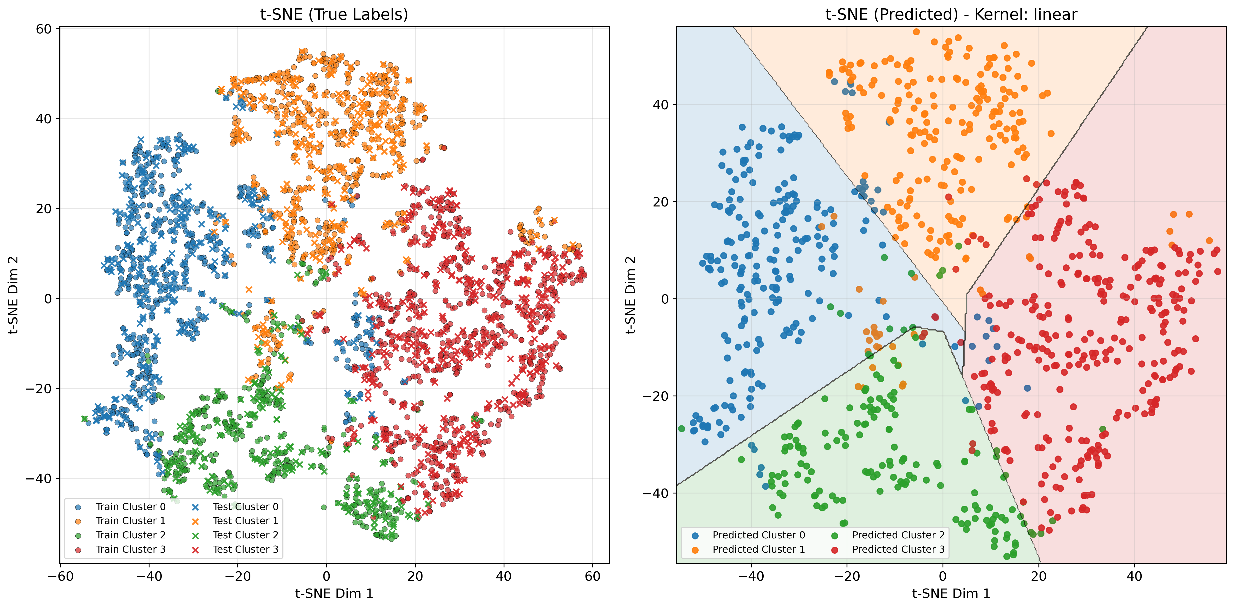
Notes:
t-SNE Visualization with SVC Decision Boundaries
The t-SNE (t-Distributed Stochastic Neighbor Embedding) plots show how our 5-dimensional earthquake data
(latitude, longitude, depth, magnitude, time) projects into 2D space for visualization purposes.
Left Panel (True Labels): Shows the actual cluster assignments from unsupervised learning
- Training points (circles): Used to train the SVC classifier
- Test points (X markers): Held out for evaluation
Right Panel (SVC Predictions): Shows classifier predictions with decision boundaries
- Colored regions: Areas where SVC predicts each cluster
- Boundary lines: Hyperplanes separating different cluster regions
- Points: Test set predictions colored by SVC output

Slide 26
Best Hyperparameters
XGBoost
max_depth: 5
min_child_weight: 5
learning_rate: 0.2
subsample: 0.8
colsample_bytree: 0.8

Slide 27
SVC Classification Report
Class | Precision | Recall | F1-Score | Support
0 | 1.00 | 0.99 | 0.99 | 232
1 | 1.00 | 0.99 | 0.99 | 227
2 | 0.97 | 0.99 | 0.98 | 157
3 | 1.00 | 0.99 | 0.99 | 299
Accuracy |  |  | 0.99 | 915
Macro Avg | 0.99 | 0.99 | 0.99 | 915
Weighted Avg | 0.99 | 0.99 | 0.99 | 915
Test Accuracy: 0.9913
Cross-validation Score: 0.9892

Slide 28
XGBoost Classification Report
Class | Precision | Recall | F1-Score | Support
0 | 0.97 | 0.96 | 0.97 | 232
1 | 0.95 | 0.93 | 0.94 | 227
2 | 0.93 | 0.96 | 0.94 | 157
3 | 0.97 | 0.97 | 0.97 | 299
Accuracy |  |  | 0.9585 | 915
Macro Avg | 0.95 | 0.96 | 0.96 | 915
Weighted Avg | 0.96 | 0.96 | 0.96 | 915
Test Accuracy: 0.9585
Cross-validation Score: 0.9550

Slide 29
Best Model: SVC

Slide 30
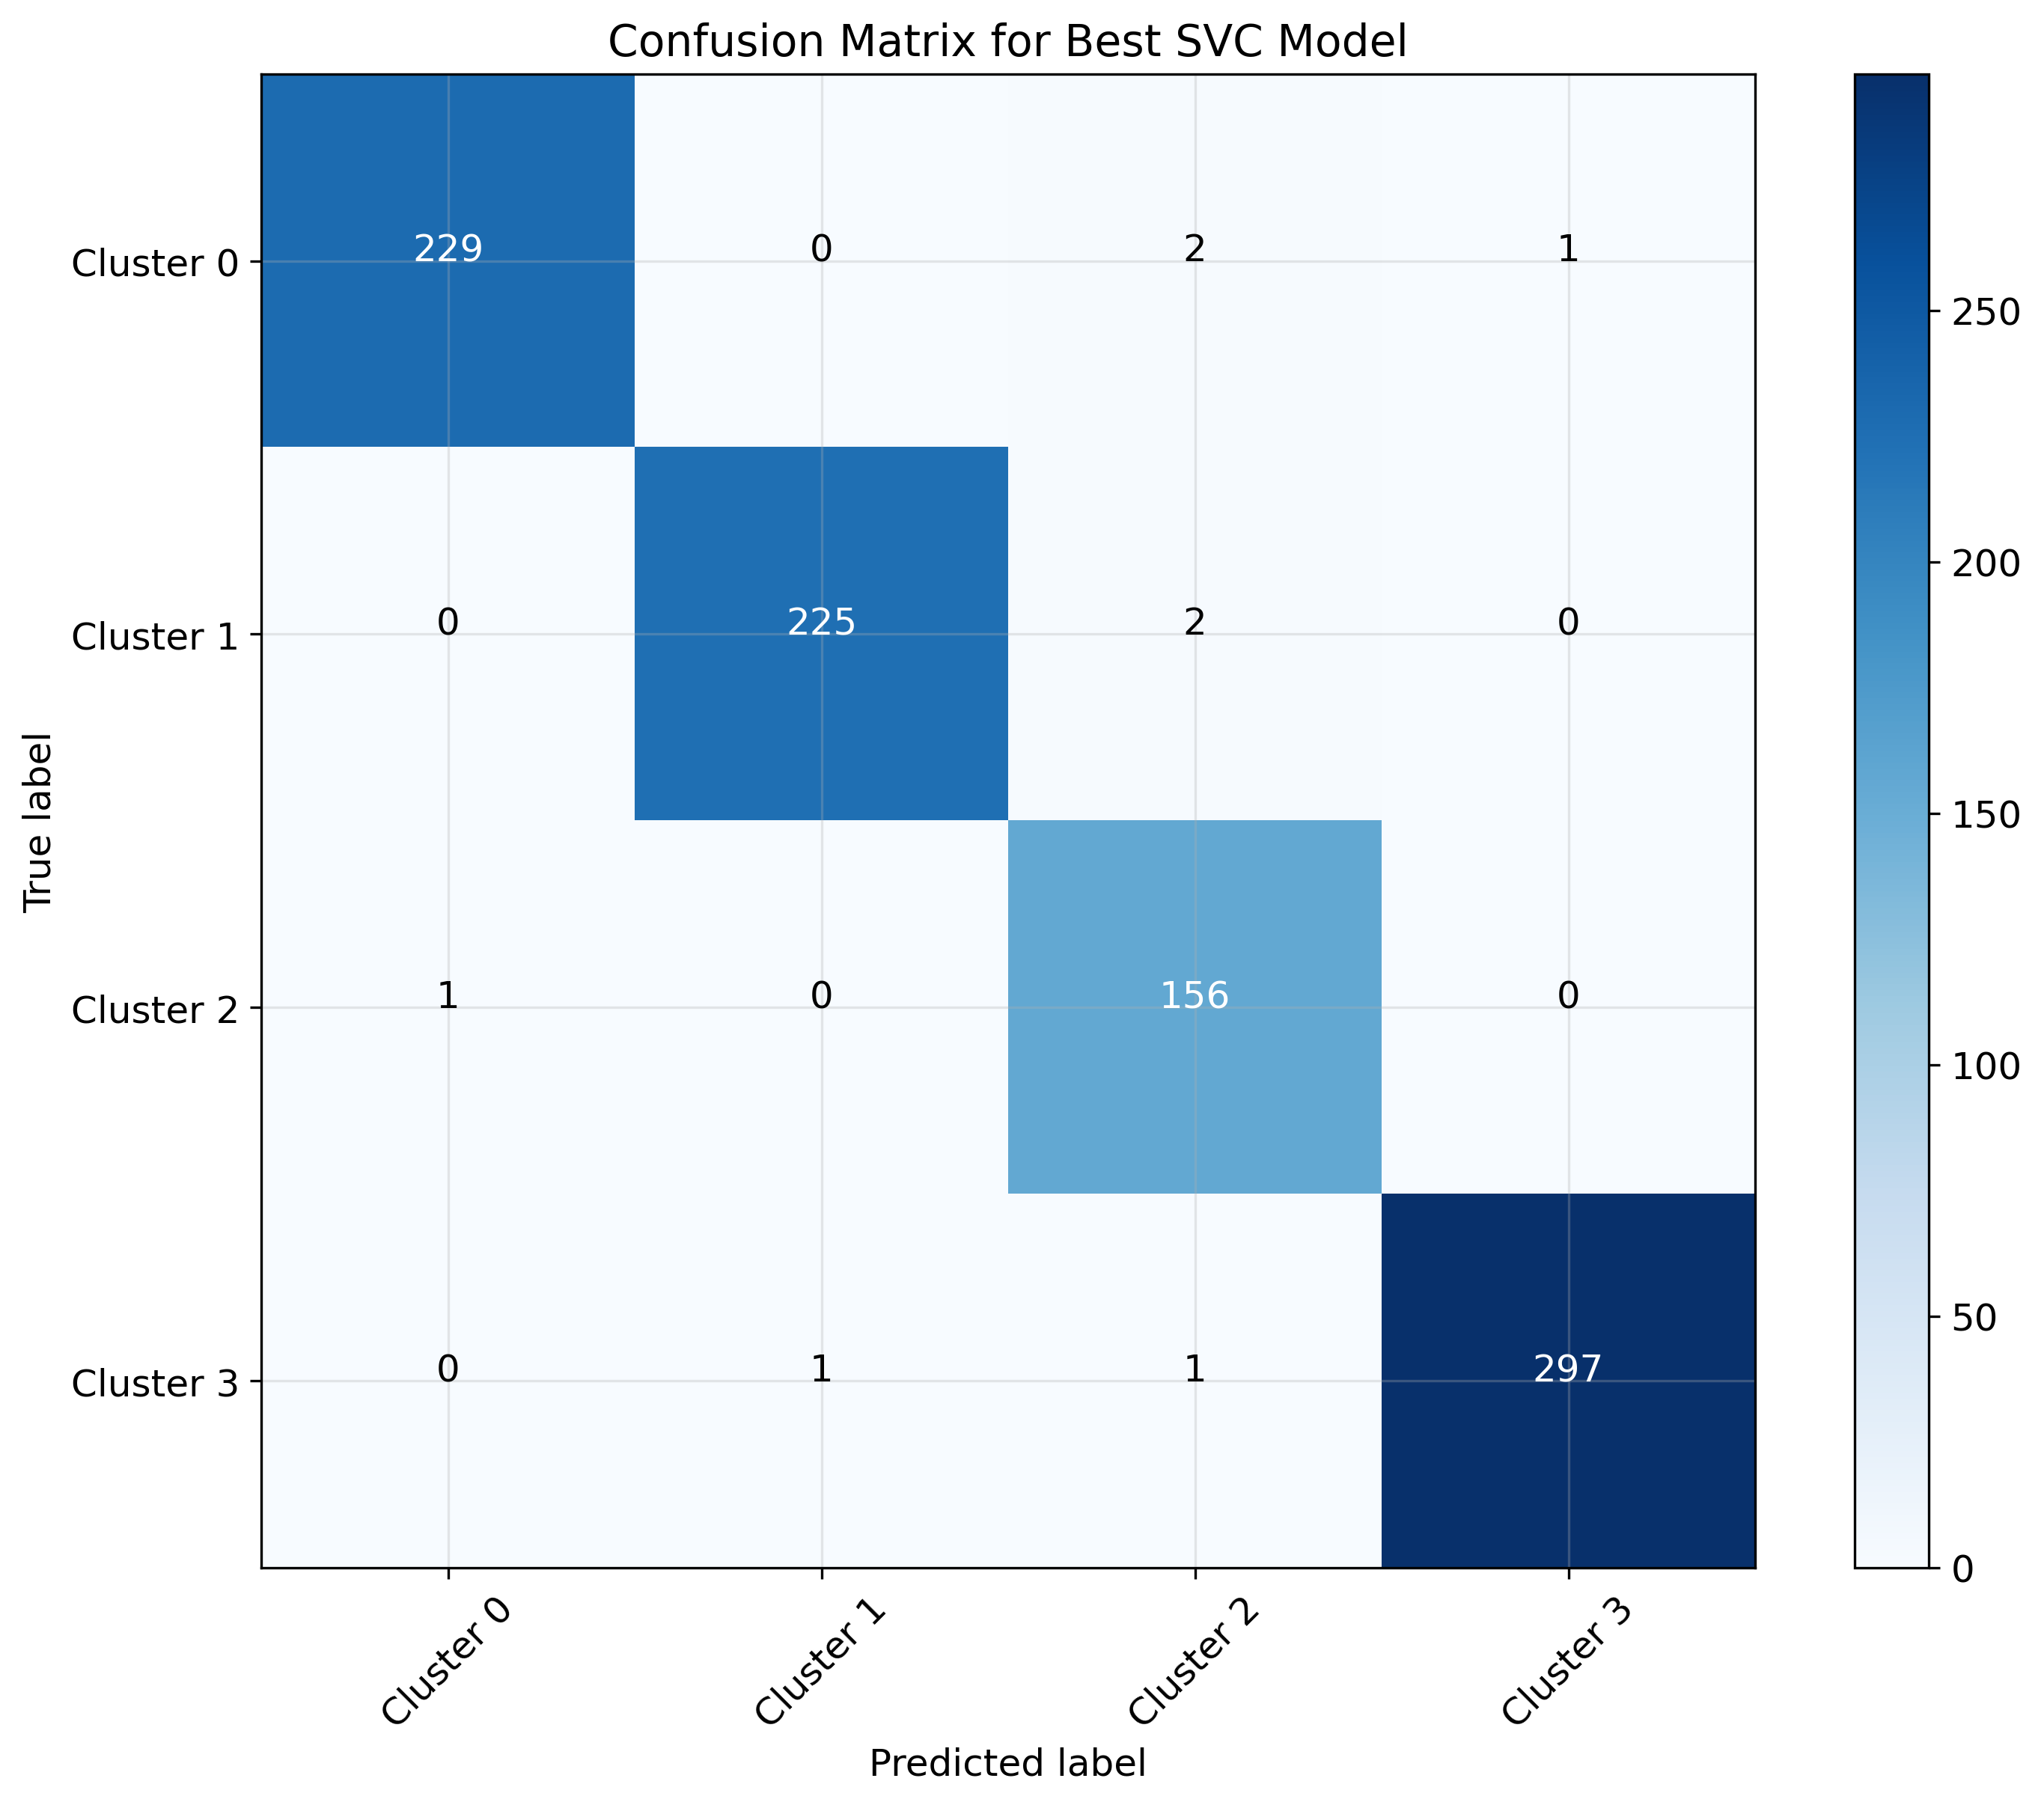
Among 915 earthquake samples in the test set,
Cluster 0:
229 samples correctly identified
Actual Count: 232
Cluster 1:
225 samples correctly identified
Actual Count: 227
Cluster 2:
156 samples correctly identified
Actual Count: 157
Cluster 3:
297 samples correctly identified
Actual Count: 299

Slide 31
Conclusion
The results of this study demonstrate that the aftershock sequence of the 2025 Bogo City earthquake indeed forms distinct and separable clusters shaped by variations in location, depth, magnitude, and event timing.
The unsupervised clustering algorithms, K-Means and K-Medoids, consistently revealed natural groupings within the dataset, indicating underlying structure in the aftershock behavior.
These findings were further validated through supervised classification, where both SVC and XGBoost achieved high separability across the cluster labels. And identified SVC as the best models.
The strong classification performance confirms that the feature relationships inferred during the unsupervised stage are reliable and meaningful.
Overall, the integration of unsupervised and supervised learning provides a robust methodological framework for characterizing aftershock patterns and offers valuable insights into the seismic behavior of the newly identified Bogo Bay fault.

Slide 32
Analyzing Aftershock Sequences in Bogo City, Cebu using Unsupervised and Supervised Learning
Charrie Anne S. Nacor
Joanna Marie M. Pagtalunan

